Slide 1

COMPUTER APPLICATION · SECTION 4
Hypothesis tests for the mean
Is the difference real, or just chance?
Horus University · 2026/2027

Slide 2
BEFORE WE START
3.7 out of 5: do students really approve?
We asked 12 students about e-learning and their average attitude was 3.7, above the neutral 3. Ask 12 other students and we might get 2.9.
Before telling management “students approve”, we need a test that answers: is the difference real, or chance?
Computer Application · Section 4
02
Notes:
Ask: is an average of 3.7 from a small sample enough to move whole courses online? Take a few answers, then say: a hypothesis test is the tool that settles it.

Slide 3
TODAY
What we cover today
01
Statistical hypotheses: null, alternative, and the decision rule
02
The one-sample t-test
03
The paired-samples t-test
04
Applying both to the case: students’ attitude to e-learning
05
Reading the output: multiple-choice questions
Computer Application · Section 4
03

Slide 4

01
Statistical hypotheses
A claim we test, and one rule to judge it
Computer Application · Section 4
04

Slide 5
CASE STUDY
From reliability to a decision
Where we are
The variable
Management asks
A reliable questionnaire
Attitude score
Two questions today
In Section 3 we dropped q4, so the five items became reliable (alpha = .828); then the questionnaire went out to students.
The student’s average over the five items, from 1 to 5. A quantitative (Scale) variable; 3 means neutral.
Do students’ attitudes differ from neutral? Did trying online study change their minds?
We answer both with a t-test: one sample, then paired samples
Computer Application · Section 4
05
Notes:
The attitude score is made in SPSS with Transform › Compute Variable as the mean of q1, q2, q3, q5 and q6. Today the score is given ready so we can focus on the test. Part A (gender, faculty) is kept for the independent-groups section.

Slide 6
DEFINITION
What is a statistical hypothesis?
A claim or guess about a population parameter (such as the mean μ) whose truth we want to test.
H0
H1
The null hypothesis
The alternative hypothesis
No difference or change. Any gap between sample and population is due to chance.
There is a real difference or change. It is the opposite of the null.
Our case: mean attitude = 3
Our case: mean attitude ≠ 3
Computer Application · Section 4
06
Notes:
The null always has the equals sign; the alternative has not-equal. We start by assuming no difference, and the data has to convince us otherwise.

Slide 7
THE PROCEDURE
Three steps and one decision rule
1
State the hypotheses (H0 and H1)
Sig ≥ α
2
Run the test in SPSS
Accept H0, reject H1
3
Compare Sig with the significance level α
The difference in the sample could be chance.
Significance level α = 1 − confidence level. 95% confidence means α = 0.05; 99% means α = 0.01.
Sig < α
Reject H0, accept H1
The difference is real (significant), not chance.
Computer Application · Section 4
07
Notes:
Sig is the chance of seeing a difference this big if the null were true; the smaller it is, the less likely the difference is chance. Note: strictly we “fail to reject” H0 rather than “accept” it, but we keep the lecture’s wording.

Slide 8

02
One-sample t-test
Does the population mean equal a given value?
Computer Application · Section 4
08

Slide 9
One Sample T-Test
When and how
Analyze
›
Compare Means
›
One Sample T-Test
When?
1
Enter the data, then follow the menu path above.
When we compare the mean of one quantitative variable with a hypothesised value μ0 given in the question.
2
Move the variable into Test Variable(s).
3
Type the hypothesised value from the question in Test Value.
H0: μ = μ0
4
To set the confidence level, click Options and type it.
H1: μ ≠ μ0
5
Click Continue, then OK.
Computer Application · Section 4
09
Notes:
Test Value is the key box: leave it empty and SPSS compares the mean with zero. The confidence level in Options only changes the confidence interval; we use it to know α.

Slide 10
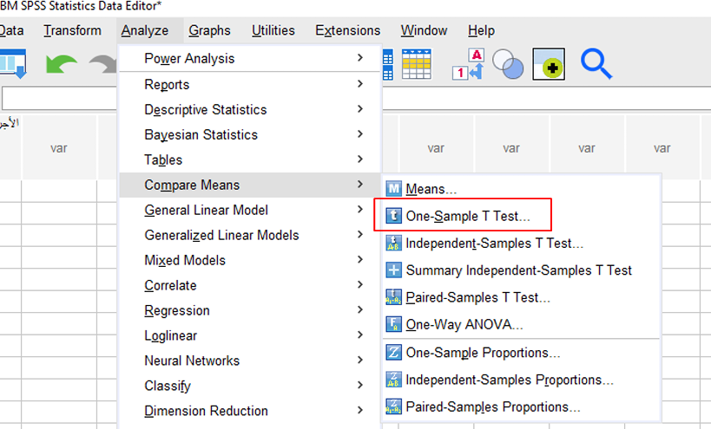
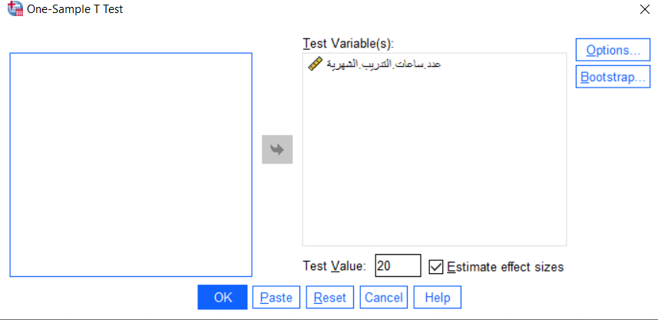
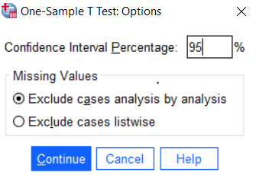
IN SPSS
One-sample t-test step by step
1
Analyze › Compare Means › One-Sample T Test
2
Move the variable to Test Variable(s) and type the Test Value
3
In Options, type the confidence level, then Continue
Computer Application · Section 4
10

Slide 11
EXAMPLE 1
Monthly training hours
The company aims for 20 training hours a month per employee. These are the monthly training hours of 10 randomly chosen employees.
Employee | 1 | 2 | 3 | 4 | 5 | 6 | 7 | 8 | 9 | 10
Training hours (hours) | 18 | 22 | 15 | 20 | 14 | 25 | 21 | 16 | 23 | 30
Your task
1
Enter the data in SPSS as one variable, hours.
2
Does the mean monthly training differ significantly from 20 hours at 0.95 confidence?
Computer Application · Section 4
11
Notes:
Test Value = 20; 95% confidence means α = 0.05. Have students write the hypotheses before running SPSS.

Slide 12
EXAMPLE 1 · ANSWER
The gap is chance: target met
H0: μ = 20
Null: no significant difference
H1: μ ≠ 20
Alternative: a significant difference
One-Sample Statistics
One-Sample Test · Test Value = 20
 | N | Mean | Std. Deviation | Std. Error Mean
hours | 10 | 20.40 | 4.926 | 1.558
 | t | df | Sig. (2-tailed) | Mean Difference | 95% CI Lower | 95% CI Upper
hours | .257 | 9 | .803 | .400 | -3.12 | 3.92
Sig = 0.803 > α = 0.05: accept H0, reject H1
Mean training (20.4 h) does not differ significantly from 20 hours; the 0.4-hour gap could be chance.
Computer Application · Section 4
12
Notes:
Only the Sig. (2-tailed) column decides. Newer SPSS also prints a One-Sample Effect Sizes table (shown in the lecture); we do not need it here.

Slide 13
CASE STUDY
Are students neutral about e-learning?
Management asks: does students’ attitude differ from neutral (3)? We picked 12 respondents at random; here is each one’s attitude score.
Student | 1 | 2 | 3 | 4 | 5 | 6 | 7 | 8 | 9 | 10 | 11 | 12
Attitude to e-learning (attitude) | 3.8 | 4.2 | 3.4 | 2.8 | 4.0 | 3.6 | 4.4 | 3.0 | 3.8 | 3.2 | 4.6 | 3.4
Your task
1
Define attitude in Variable View (Scale, Decimals = 1) and enter the scores.
2
Test at 95% confidence whether the mean attitude differs from 3. What do we tell management?
Computer Application · Section 4
13
Notes:
Why 3? It is the midpoint of the Likert scale (neutral). Significantly above 3 means students approve; significantly below means they oppose.

Slide 14
CASE 1 · ANSWER
Students are not neutral: they lean positive
H0: μ = 3
Null: attitude is neutral
H1: μ ≠ 3
Alternative: attitude differs from neutral
One-Sample Statistics
One-Sample Test · Test Value = 3
 | N | Mean | Std. Deviation | Std. Error Mean
attitude | 12 | 3.68 | .556 | .160
 | t | df | Sig. (2-tailed) | Mean Difference | 95% CI Lower | 95% CI Upper
attitude | 4.260 | 11 | .001 | .683 | .33 | 1.04
Sig = 0.001 < α = 0.05: reject H0, accept H1
Mean Difference is positive (3.68 is above 3), so the attitude is positive. For management: “Students’ attitude to e-learning is significantly positive.”
Computer Application · Section 4
14
Notes:
The test says whether there is a difference; the sign of Mean Difference says which way. The confidence interval (.33 to 1.04) is all positive and excludes zero, which agrees with rejecting H0.

Slide 15

03
Paired samples
The same people before and after: did anything change?
Computer Application · Section 4
15

Slide 16
Paired Samples T-Test
When and how
Analyze
›
Compare Means
›
Paired-Samples T Test
When?
1
Enter the data in two columns (before, after): one row per person.
When we measure the same people twice (before and after) and want to know whether the mean changed.
2
Follow the path above and move both variables into Paired Variables.
3
To set the confidence level, click Options and type it.
H0: μ1 = μ2
4
Click Continue, then OK.
H1: μ1 ≠ μ2
Computer Application · Section 4
16
Notes:
The idea: SPSS takes each person’s difference (before − after) and tests whether the mean difference is zero, so each person must stay on one row.

Slide 17
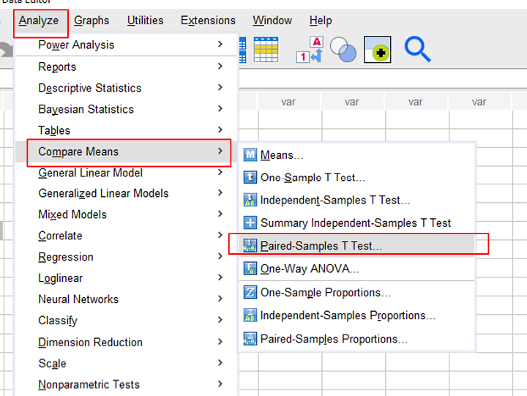
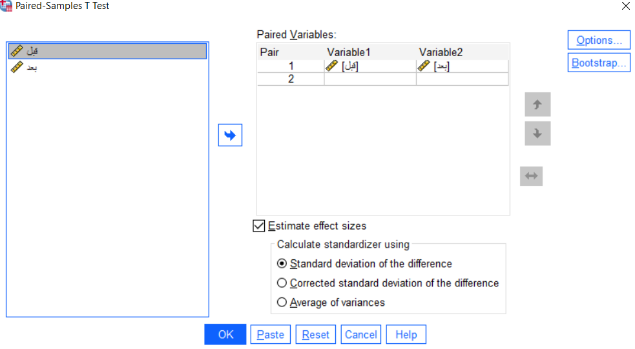
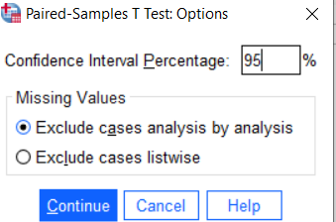
IN SPSS
Paired-samples t-test step by step
1
Analyze › Compare Means › Paired-Samples T Test
2
Put before in Variable1 and after in Variable2
3
In Options, type the confidence level, then Continue
Computer Application · Section 4
17

Slide 18
EXAMPLE 3
A new task-management program
Employee | Before (before) | After (after)
1 | 20 | 19
2 | 18 | 17
3 | 25 | 24
4 | 15 | 16
5 | 25 | 24
6 | 18 | 12
A company wants to know whether a new task-management program cuts the weekly errors of its customer-service staff. It picked 6 employees and recorded each one’s weekly errors before and after.
Your task
1
Does the new system have a significant effect on mean weekly errors? (Assume a normal population.)
2
Use 95% confidence.
Computer Application · Section 4
18
Notes:
Correction: the lecture’s table has 18 for employee 5 after, but its SPSS solution (Sig = 0.178) was run with 24. We use 24 so students reproduce the lecture’s answer. With 18, Sig = 0.115 and the decision is the same.

Slide 19
EXAMPLE 3 · ANSWER
No significant effect
H0: μ1 = μ2
Null: no change
H1: μ1 ≠ μ2
Alternative: a change
Paired Samples Statistics
Pair 1 | Mean | N | Std. Deviation | Std. Error Mean
before | 20.17 | 6 | 4.070 | 1.662
after | 18.67 | 6 | 4.719 | 1.926
Paired Samples Test · Paired Differences
Pair 1 | Mean | Std. Deviation | Std. Error Mean | 95% CI Lower | 95% CI Upper | t | df | Sig. (2-tailed)
before - after | 1.500 | 2.345 | .957 | -.961 | 3.961 | 1.567 | 5 | .178
Sig = 0.178 > α = 0.05: accept H0, reject H1
Errors fell by 1.5 on average in the sample, but the drop is not significant: it could be chance.
Computer Application · Section 4
19
Notes:
SPSS also prints Paired Samples Correlations (r = .868 between before and after); it is not used for the decision. Mean = before − after = 1.5, positive, so errors went down.

Slide 20
CASE STUDY
Did trying online change students’ minds?
Student | Attitude before (att_before) | Attitude after (att_after)
1 | 2.6 | 3.2
2 | 3.0 | 3.6
3 | 2.4 | 3.0
4 | 3.4 | 3.8
5 | 2.8 | 3.4
6 | 3.2 | 3.2
7 | 2.2 | 3.0
8 | 2.8 | 3.6
Before deciding, the university taught one course fully online for two weeks to 8 students and measured their attitude score before and after.
Your task
1
Enter the two columns and test the difference at 99% confidence.
2
What is the decision? Did attitudes improve or worsen?
Computer Application · Section 4
20
Notes:
Why paired? The same eight students are measured twice. Note the confidence level is 99% here, so α = 0.01.

Slide 21
CASE 2 · ANSWER
The trial improved attitudes
H0: μ1 = μ2
Null: no change
H1: μ1 ≠ μ2
Alternative: a change
Paired Samples Statistics
Pair 1 | Mean | N | Std. Deviation | Std. Error Mean
att_before | 2.80 | 8 | .400 | .141
att_after | 3.35 | 8 | .298 | .105
Paired Samples Test · Paired Differences
Pair 1 | Mean | Std. Deviation | Std. Error Mean | 99% CI Lower | 99% CI Upper | t | df | Sig. (2-tailed)
att_before - att_after | -.550 | .256 | .091 | -.867 | -.233 | -6.068 | 7 | .001
Sig = 0.001 < α = 0.01: reject H0, accept H1
Mean = before − after = −0.55 (negative), so attitudes are higher after the trial: from 2.80 to 3.35.
Computer Application · Section 4
21
Notes:
SPSS subtracts Variable1 − Variable2 in the order entered. Put att_after first and the sign flips; the decision stays. For management: “Two weeks of online study significantly improved students’ attitude.”

Slide 22
WATCH OUT
Know α before you compare
α = 1 − the confidence level in the question. At 95% we compare Sig with 0.05; at 99%, with 0.01. Sig = 0.03 rejects H0 in the first case and accepts it in the second.
Computer Application · Section 4
22
Notes:
The most common exam mistake: always comparing with 0.05. Example 2, next, uses 99% confidence.

Slide 23

04
Read the output
Multiple-choice questions on ready-made output
Computer Application · Section 4
23

Slide 24
EXAMPLE 2
Answer from the output
One-Sample Statistics
One-Sample Test · Test Value = 300
 | N | Mean | Std. Deviation | Std. Error Mean
wage | 10 | 407.80 | 161.560 | 51.090
 | t | df | Sig. (2-tailed) | Mean Difference | 99% CI Lower | 99% CI Upper
wage | 2.110 | 9 | .064 | 107.800 | -58.23 | 273.83
a
Quantitative, Scale
b
Qualitative, Nominal
c
Qualitative, Ordinal
1
Variable type and measure:
d
Quantitative, Nominal
2
The hypothesised value μ0 is:
a
500
b
0.64
c
300
d
10
3
The confidence level:
a
0.05
b
99%
c
1%
d
10%
4
The significance level:
a
0.05
b
99%
c
1%
d
10%
Computer Application · Section 4
24
Notes:
Answers: 1: a | 2: c | 3: b | 4: c. Read the confidence level from the interval heading (99%), so α = 1%.

Slide 25
EXAMPLE 2
Answer from the output
One-Sample Statistics
One-Sample Test · Test Value = 300
 | N | Mean | Std. Deviation | Std. Error Mean
wage | 10 | 407.80 | 161.560 | 51.090
 | t | df | Sig. (2-tailed) | Mean Difference | 99% CI Lower | 99% CI Upper
wage | 2.110 | 9 | .064 | 107.800 | -58.23 | 273.83
5
The sample size:
a
300
b
9
c
10
d
10%
6
Compared with the significance level, Sig is:
a
Larger
b
Smaller
7
In this test we:
a
Accept H0, reject H1
b
Reject H0, accept H1
Computer Application · Section 4
25
Notes:
Answers: 5: c | 6: a | 7: a. Sig = 0.064 > α = 0.01, so accept H0. Even at 95% confidence, 0.064 would still be above 0.05.

Slide 26
EXAMPLE 4
Answer from the output
Paired Samples Statistics
Pair 1 | Mean | N | Std. Deviation | Std. Error Mean
before | 15.67 | 6 | 5.538 | 2.261
after | 19.83 | 6 | 3.817 | 1.558
Paired Samples Test · Paired Differences
Pair 1 | Mean | Std. Deviation | Std. Error Mean | 95% CI Lower | 95% CI Upper | t | df | Sig. (2-tailed)
before - after | -4.167 | 2.639 | 1.078 | -6.937 | -1.397 | -3.867 | 5 | .012
1
The confidence level is:
a
95%
b
5%
c
6
d
2.693
2
The significance level is:
a
95%
b
5%
c
6
d
2.693
3
Sig for this test:
a
95%
b
5%
c
0.012
d
2.693
Computer Application · Section 4
26
Notes:
Answers: 1: a | 2: b | 3: c. The lecture’s output also shows Paired Samples Correlations (r = .905, Sig = .013): do not confuse that Sig with the test’s Sig.

Slide 27
EXAMPLE 4
Answer from the output
Paired Samples Statistics
Pair 1 | Mean | N | Std. Deviation | Std. Error Mean
before | 15.67 | 6 | 5.538 | 2.261
after | 19.83 | 6 | 3.817 | 1.558
Paired Samples Test · Paired Differences
Pair 1 | Mean | Std. Deviation | Std. Error Mean | 95% CI Lower | 95% CI Upper | t | df | Sig. (2-tailed)
before - after | -4.167 | 2.639 | 1.078 | -6.937 | -1.397 | -3.867 | 5 | .012
4
Compared with the significance level, Sig is:
a
Larger
b
Smaller
5
In this test we:
a
Accept H0, reject H1
b
Reject H0, accept H1
Computer Application · Section 4
27
Notes:
Answers: 4: b | 5: b. Sig = 0.012 < α = 0.05, so reject H0: there is a significant before/after difference.

Slide 28
WRAP-UP
What to remember
1
2
3
Hypotheses first
Which test?
The decision rule
H0: no difference. H1: a difference. Write both before running SPSS.
A mean against a fixed value: One Sample. The same people before and after: Paired Samples.
α = 1 − confidence. Sig < α: reject H0. Sig ≥ α: accept H0.
Computer Application · Section 4
28

